Slide 1
Final Project
Arip Nur
Naveen Koniki

Slide 2
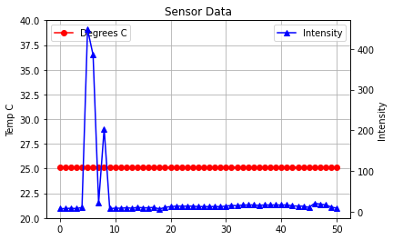
Testing (inside building)

Slide 3
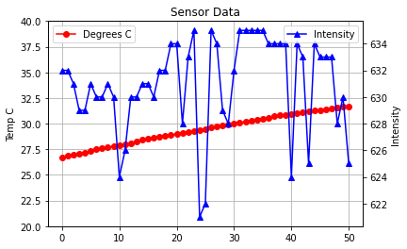
Experiment (Outside building)

Slide 4
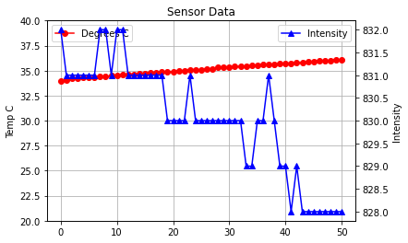
Experiment (Outside building)

Slide 5
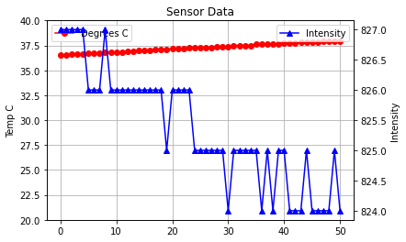
Experiment (Outside building)

Slide 6
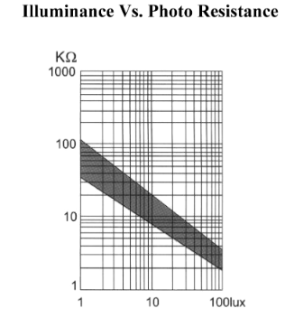
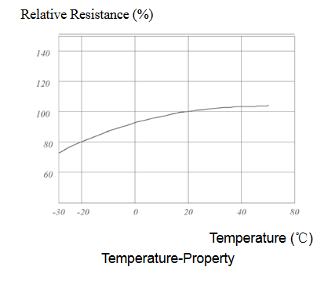
Photoresistor Datasheet
https://cdn.sparkfun.com/datasheets/Sensors/LightImaging/SEN-09088.pdf
https://www.kth.se/social/files/54ef17dbf27654753f437c56/GL5537.pdf

Slide 7
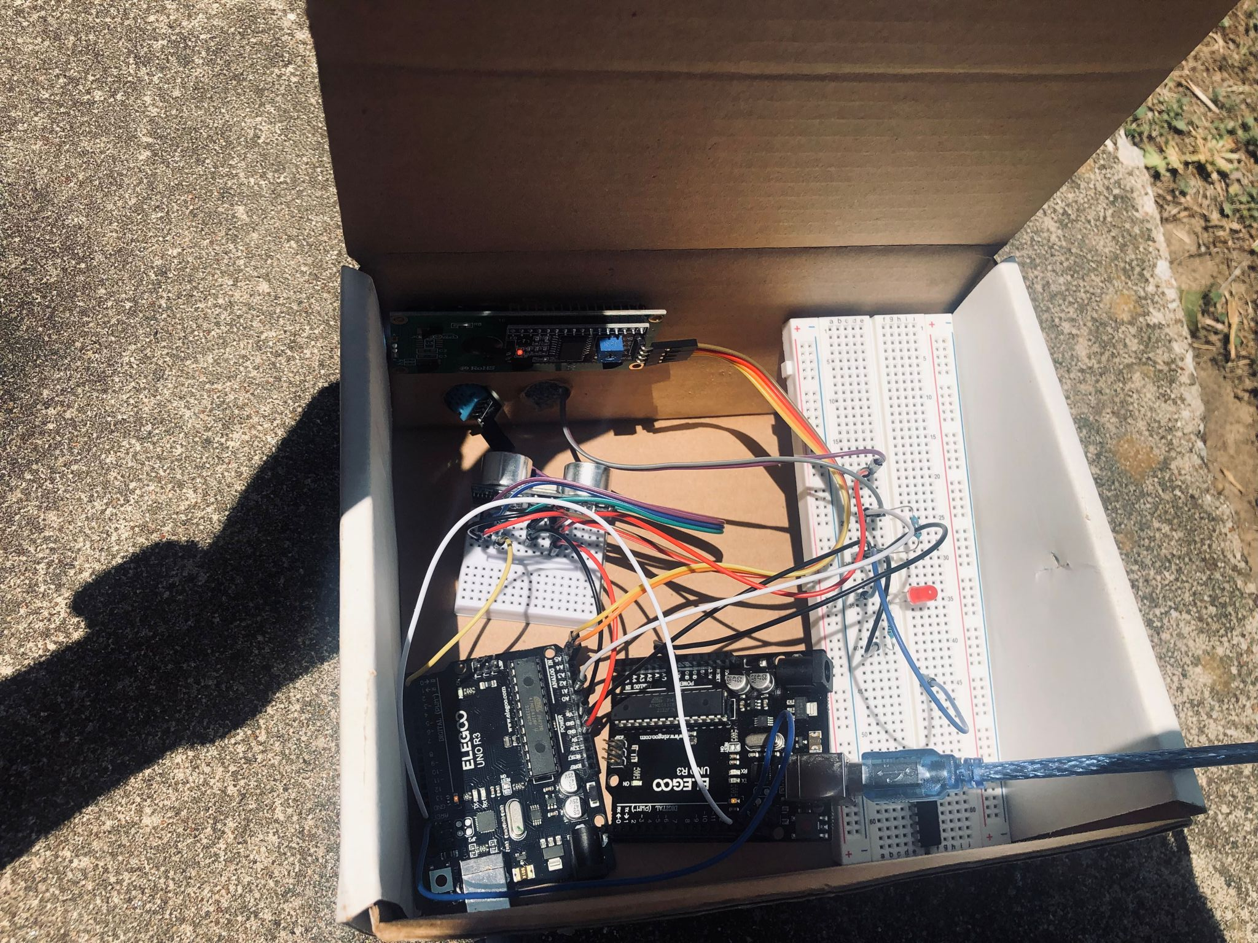
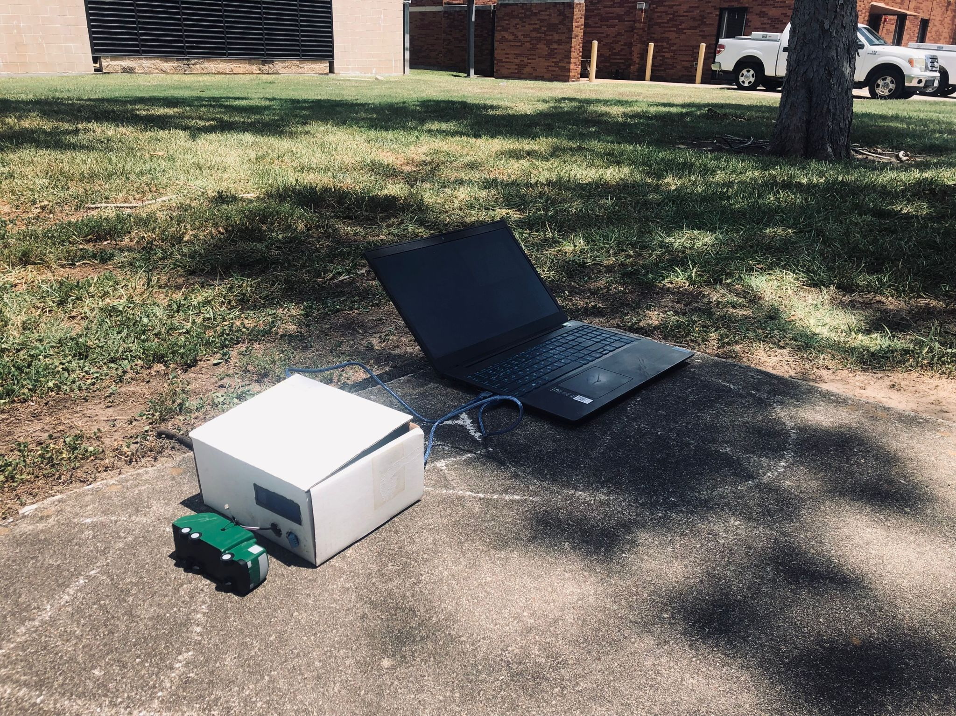
Photos

Slide 8
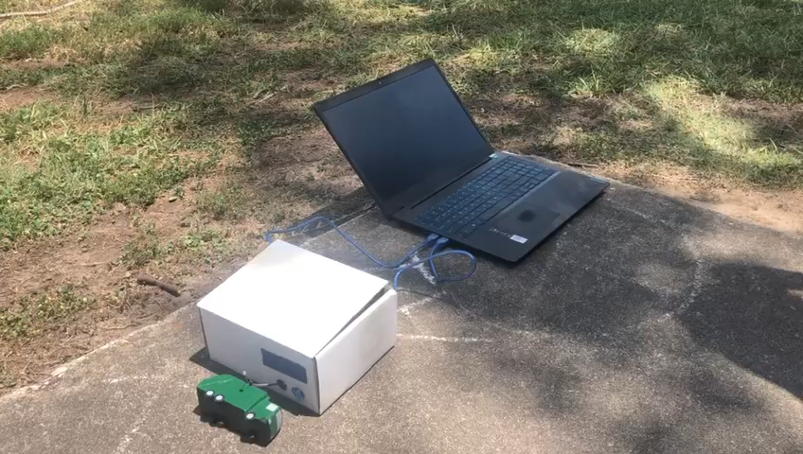
Video

